Slide 2
Notes:
Bringing the hearts and hands of God's people together to transform resources into humanitarian relief.

Slide 3
Notes:
We send tangible resources to those in need to make an intangible difference in their lives through hope and empowerment. In times of crisis internationally and in the United States, Disaster Relief, Health, Education, and Micro Business supplies are given freely through trusted partner nonprofits.

Slide 4
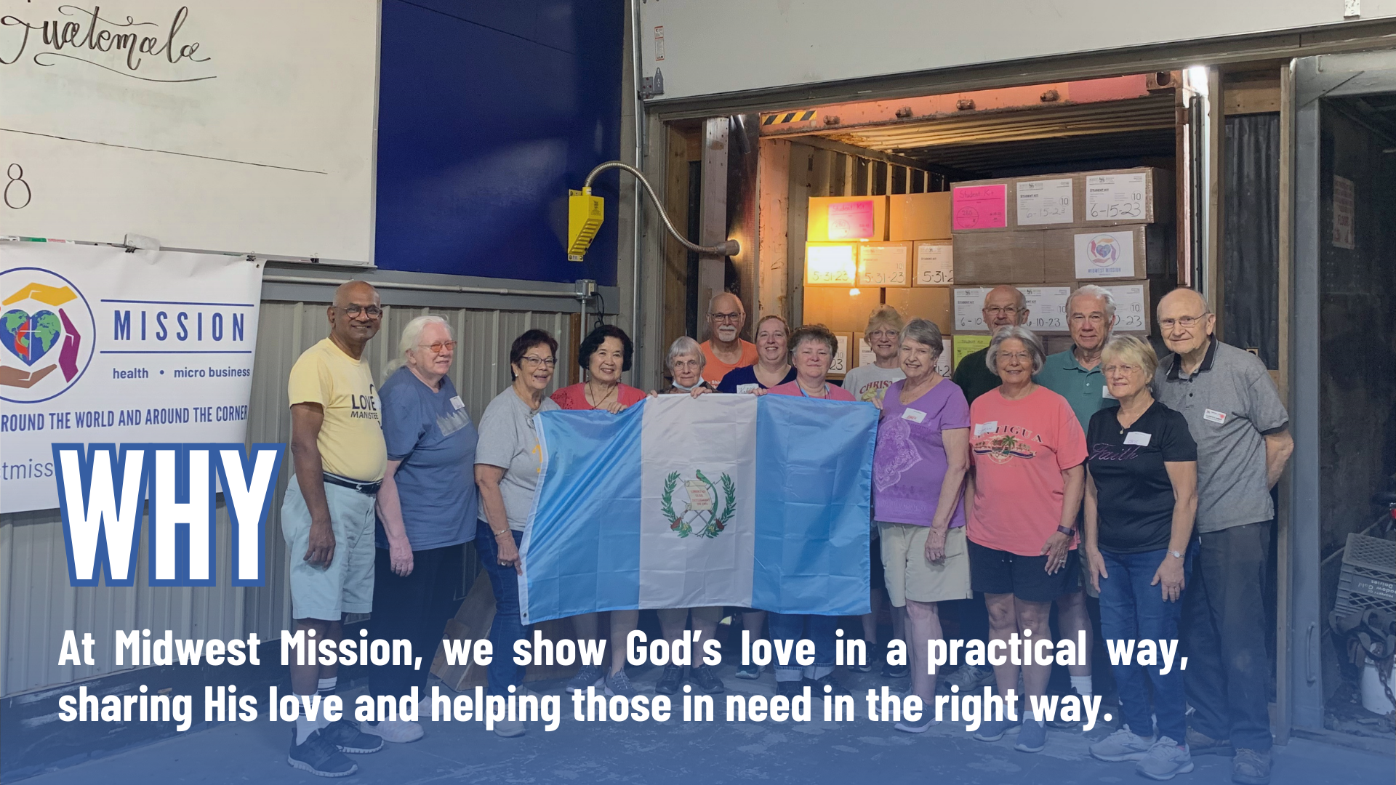
Notes:
Around the world and around the corner, people are in need of basic resources that would give them a hand up in life. As Christians, our mission is to show God’s love. At Midwest Mission, we show God’s love in a practical way, sharing His love and helping those in need in the right way.
“And God is able to bless you abundantly, so that in all things at all times, having all that you need, you will abound in every good work.” 1 Corinthians 9:8

Slide 5
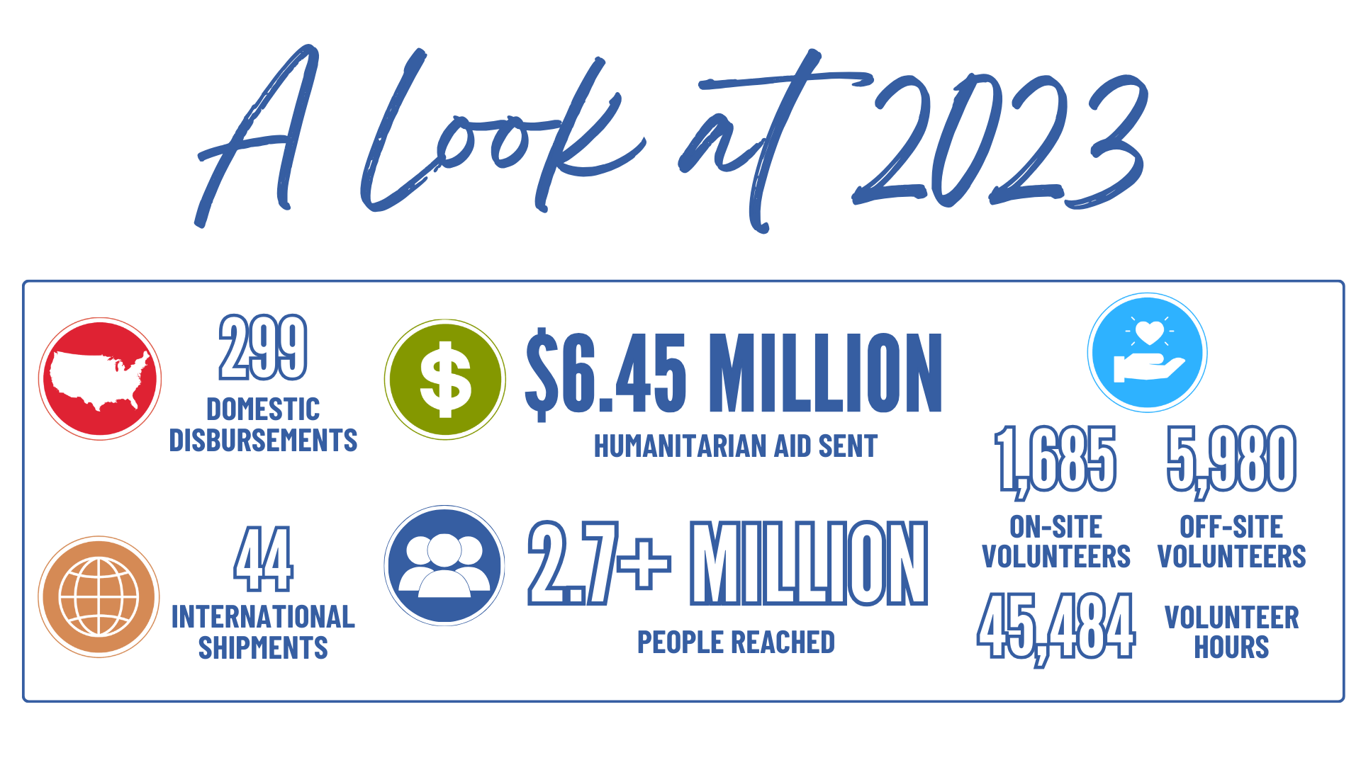
Notes:
Because of your generosity, people around the world and around the corner are filled with hope.

Slide 7
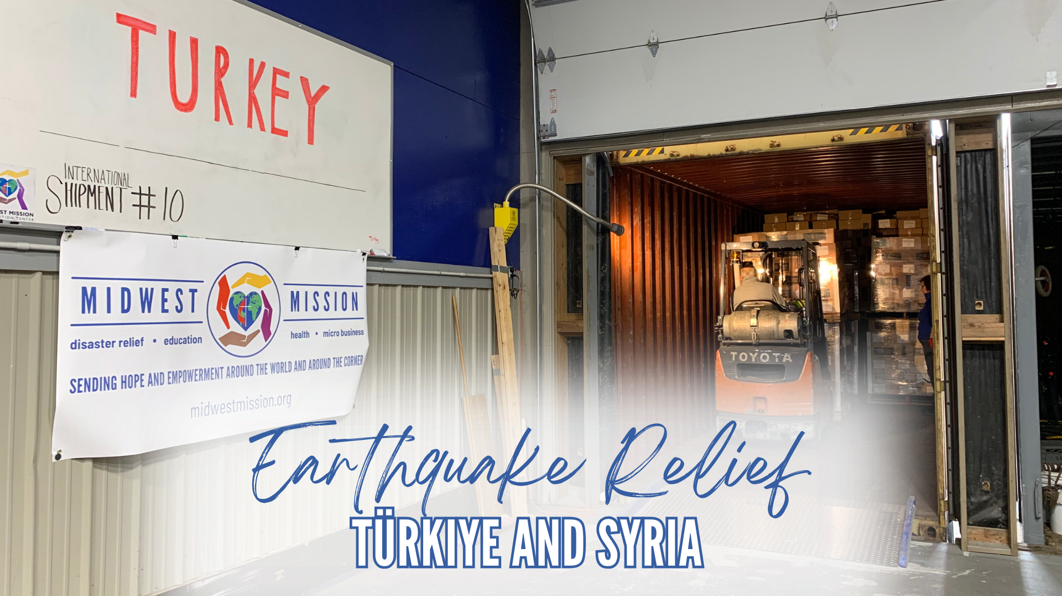
Notes:
On February 6, 2023, a 7.8 magnitude earthquake struck Türkiye and Syria, impacting the lives of an estimated 15.7 million people (U.N. Refugee Agency).
While we watched the devastating scene unfold, thousands of miles away, we knew response was going to be needed.
Our relationship with North Star Foundation, and the path we already had into Poland while serving Ukraine, was a perfect opportunity to quickly get supplies into Türkiye and Syria. The items would stop at a relief hub in Poland, where supplies were split up and sent in different directions with different organizations. With one shipment, we could help people in Türkiye, Syria, Poland, and Ukraine.
Initially, they needed food. We worked with the Springfield Rotary Club and Baja Bridges to send a shipment full of Meals Ready to Eat. Meanwhile, we were working hard to make Rice Meals that we would eventually send to the area.
Then, they were in desperate need of hygiene items. When North Star heard about our Personal Dignity Kits, they were ecstatic! They immediately requested them, not only for the earthquake relief, but for refugees and survivors of the war in Ukraine as well. This would add almost 20,000 more Personal Dignity Kits than we normally send in a year. We couldn’t get that much shampoo that quickly, so we called upon YOU. And you responded by leaps and bounds! We were able to send all the Personal Dignity Kits they requested over the six shipments we sent to the area in 2023.

Slide 8
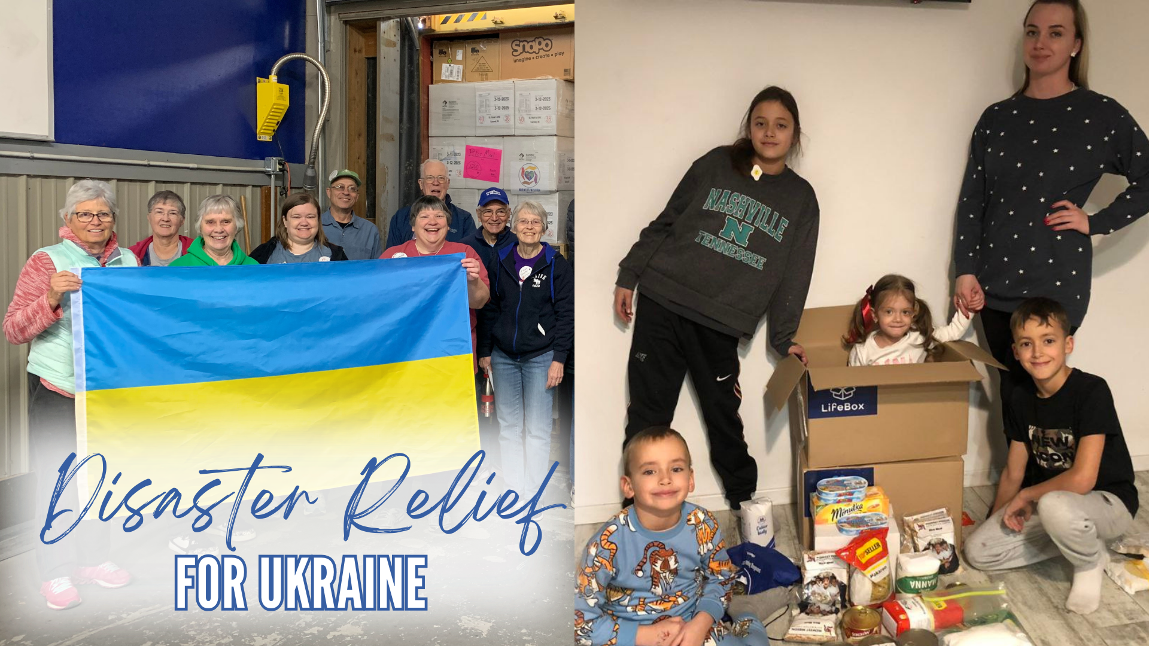
Notes:
The war in Ukraine is still ongoing. Millions are displaced from their homes, trying to build a new normal. We have been sending relief to Ukraine for almost two years, but unfortunately, many people in Ukraine are still in dire circumstances.
Many of us will never know the crushing reality of losing everything we’ve known. But those who have speak of devastating circumstances.
Although they might have a place to stay, many people still don’t have basic necessities. The need is there, and we are dedicated to responding to this humanitarian crisis as long as needed. In 2024, we will continue working with North Star to provide needed supplies when requested.
Please be praying for the people of Ukraine and for organizations who are working hard to provide needed supplies.

Slide 9
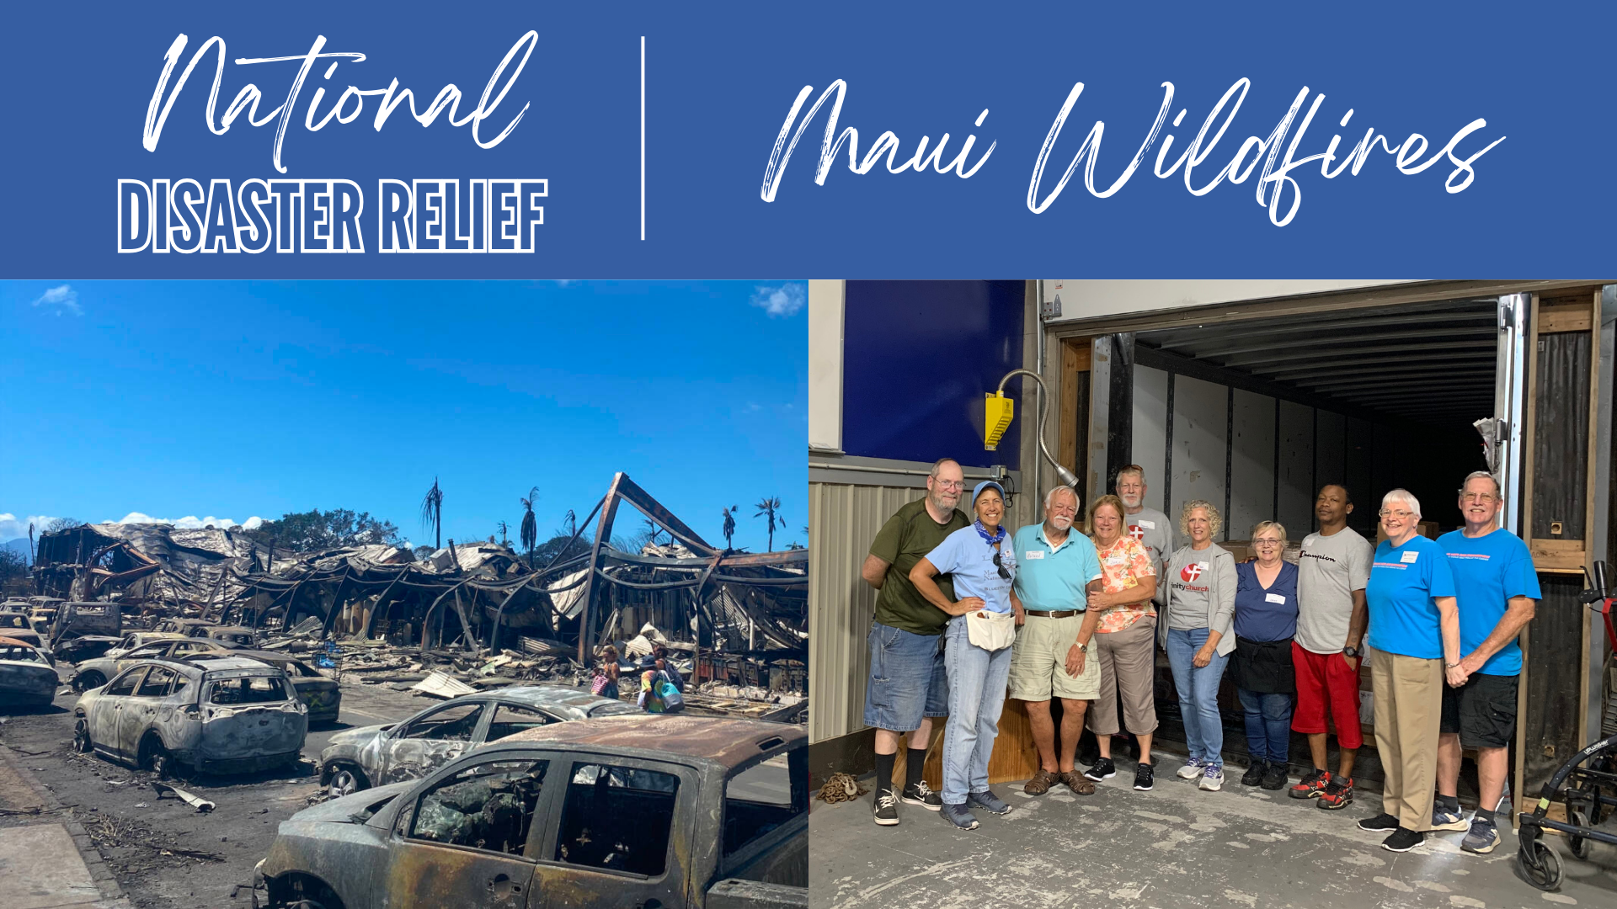
Notes:
During the second week of August, wildfires sparked around the island of Maui. Those fires led to a devastating inferno that destroyed the historic community of Lahaina.
Lahaina was made up of local residents. This was their home — not their week of vacation or temporary living. Many people had to evacuate, and lost everything. They lost physical belongings, but also pieces of their culture, their historic landmarks, and a piece of the island that was their own.
Convoy of Hope, out of Springfield, Missouri was on the ground in Lahaina distributing disaster relief within a week of the fires igniting. They were working with our food supplier for relief supplies, but they needed more than the supplier had. They suggested contacting Midwest Mission.
After discussing what we had and what their needs were, it was decided that we would send Bed Pack Kits (sheet sets and bed pillows), Hygiene Kits, and Rice Meal Bags for Convoy to distribute.
We knew other needs would arise, so we opened a Maui Campaign so that we could provide needed assistance as soon as possible.
When we ask for funds after a disaster, we will only use that money for that specific disaster, or to replenish items we sent for that disaster.
On August 28, the container arrived that would go to one of Convoy of Hope’s warehouses in Sacramento, California. Needed items would be flown to Maui. This was a special moment because NOMADS, Mark and Mary, had a son and daughter-in-law who were living in Lahaina and lost their apartment in the fire. They shared their son’s story, and we prayed for them as we prayed over the shipment.
After that shipment, we still had funds left, so we worked with Convoy of Hope to find out other priority needs. We purchased two semi-loads of rice (that’s a LOT of rice) that would go to Maui. All together, that is 77,200 pounds of rice!
Because of you, survivors were fed, and had hygiene supplies to keep a little normality in their life.

Slide 10
Notes:
Midwest Mission has committed to being a part of the United Methodist Relief Supply Network. There are eight warehouses in the relief supply network. UMCOR Sager Brown is the only warehouse owned, funded, and operated by UMCOR (Midwest Mission is not UMCOR). We pledge to build, verify, collect, warehouse, and ship UMCOR kits at our own expense. UMCOR kits are only sent within the U.S. and mostly in response to disasters.
Should I give money to Midwest Mission or UMCOR in a disaster?
Outside of UMCOR Sunday, 100% of the funds given to UMCOR goes to the Advance Fund you choose. During international disasters, UMCOR sends relief in the form of monetary grants. UMCOR no longer ships supplies internationally because shipping can be expensive and not as immediate.
However, Midwest Mission does not pay for shipping. We work with partners to receive information on the requested items needed for a disaster. Many times, these are items they are unable to find near the disaster site. Midwest Mission lets you know what the needed items are, and you can purchase them or send monetary donations for us to purchase products to be sent.
If you want to give requested, needed supplies in a disaster, Midwest Mission is your choice — whether you want to donate supplies or money. If you want to send monetary help to the disaster, then give funds to UMCOR.
We want to honor your wishes and be upfront with how we both work to complement the other’s services. Our goal is always to steward your resources well, so that we can all work together to send hope and empowerment in times of crisis around the world and around the corner.
Find a full list of questions and answers at midwestmission.org/UMCOR

Slide 12
Notes:
Visiting our partners, and spending time with people who have been on the receiving end of the work we do, has been something we’ve wanted to do for a long time. In March 2023, that finally came to fruition! We visited Food For The Poor in Jamaica, and learned so much.
At Midwest Mission, we always ask our partners what they need before sending anything; but, there is something so special about standing in the dining room of a children’s home that has received our kits for years, holding the hand of Auntie, looking her in the eyes, and asking “what do you need?”.
The people we serve alongside are some of the most selfless, caring, and servant-hearted people we have ever met. They sacrifice daily to bless those they are serving.
The work you do here in the states is truly life changing for those on the receiving end. We saw the buckets that you carefully packed and prayed over, sitting under sinks, in gardens, and throughout the houses. We heard the gravity of what receiving Personal Dignity Kits mean through choked up voices as they poured out their thanks. But, we couldn’t take credit for it — it was YOU. Your time, resources, and prayer are changing lives forever.
When we came back to the States, we reflected on everything we learned. As we asked what they needed, we made notes of how we could change what we do to be more helpful to our partners. Because of this, we have made a few kit changes that you can see on page 20. We are an organization that deeply cares about the people we serve. When we ask what they need, we want them to know we listen.

Slide 13
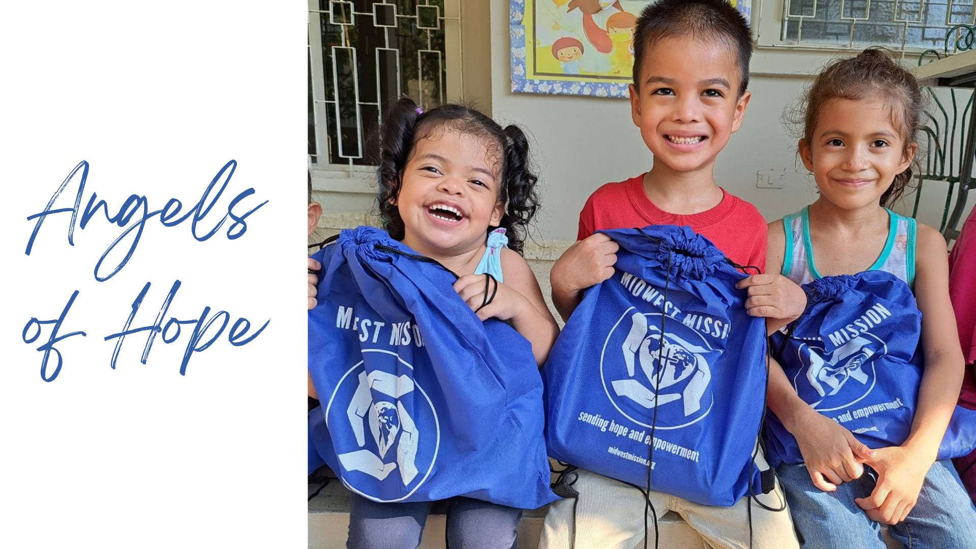
Notes:
The Angels of Hope program is a collaboration with Food For The Poor that serves children’s homes and less-fortunate families in 10 countries across Latin America and the Caribbean. In 2023, our Angels of Hope shipments contained Personal Dignity Kits, Home Care Kits, and disinfecting wipes.
In 2024, we will add twin mattresses, Cover Them with Love Quilts, and Bed Pack Kits to these shipments. In 2023, we sent Angels of Hope shipments to Honduras, Guatemala, Haiti, and Jamaica, totaling nine shipments.
Can you imagine not having the basic necessities to live a healthy life? Many families have to make tough choices about where they spend their limited income, and a lot of times they have to choose food over sanitary items. Because of your
generosity, children and families in these countries have hygiene and cleaning items to make them
and their environments healthier.
We received a Partner Report from an organization called CEPUDO in
Honduras, which brought great feedback, and this absolutely heartwarming
photo that is full of joy. This shipment contained 1,600 Personal Dignity
Kits and 400 Home Care Kits.
“We are most grateful for these Personal Dignity Kits because they
provide what the children need,” Heydy, Food For The Poor’s
in-country representative said.
“The children love them, too, because they know that each kit is
their own,” she continued.
“A total of 33 households throughout Honduras received the kits
and both children’s homes and impoverished families were especially
happy to receive practical items for use in their daily lives.”

Slide 14
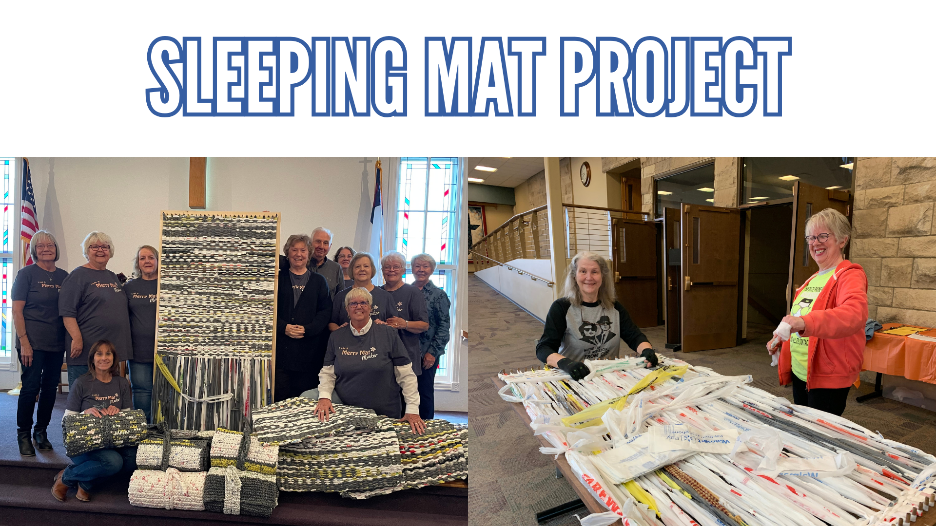
Notes:
This year, our Sleeping Mat Project really began to take off in churches and communities around the Midwest. These Sleeping Mats are made out of plastic grocery bags using a loom. No matter who you are, or how old you are, you can be a part of this. This is a great project for churches and small groups! We offer looms for a $100 donation, or you can make your own using the plans found on our website.
The Sleeping Mats are given to people who are sleeping in less than desirable conditions. It gives a dry, dirt-free space to get a good night’s sleep. The mats are freely given both internationally and in the United States. To learn more, or to get a loom, go to midwestmission.org/loom or contact teresa@midwestmission.org.

Slide 16
Notes:
In July, Midwest Mission sent a shipment to the American Indian Christian Mission (AICM) in Show Low, Arizona.
This is the third shipment Midwest Mission has provided for AICM. During COVID, we sent a semi full of requested supplies such as masks and toilet paper — you probably remember the vast need for toilet paper during this time in your own communities!
AICM’s mission is to “Evangelize and Equip Native Americans for Christ.” They help Native Americans become aware of God and teach them that through Christ and Christ alone they can be saved. They have three parts to their ministry: the boarding school, outreach to families of students, and their Blue Bus ministry.
This shipment came with a God Moment. They had requested bath towels, but at the time we only had about 30 in our inventory. Just a couple days later, a donation came in that had over 500 new towels on it! We were able to send 600 towels to bless the community in Show Low.
Included in the shipment was 178 gallons of laundry detergent. You can see some of their students using the detergent in the picture below.
We also sent hygiene items, cleaning supplies, 560 Student Kits, 2,800 Rice Meal Bags, 50 mattresses, three sewing machines, and four air conditioners.
Our goal is always to listen to our partners and send what they need. Thank you, GOD, for providing!

Slide 17
Notes:
Bleacher Wood Donation
Wood Preparation - volunteers scrape the gum off, remove any metal pieces, and plane, sand, and cut pieces to size.
Desk Assembly - the desks are assembled, checked for quality, and labeled for reassembly. Then, they are disassembled for shipping. Next, each desk is polyurethaned, and then individually wrapped with all the pieces necessary for one desk.
Distribution - students around the world have a clean, hard surface to work on, providing a more functional learning environment.

Slide 18
Notes:
Since 2013 we have partnered with the United States Southern Command for their annual Humanitarian Aid Exercise.
In 11 years, we have sent supplies to six countries on 14 missions with the United States Southern Command.
​This year, the U.S. Southern Command will be holding exercises in Peru for their humanitarian mission, Resolute Sentinel. They have asked us to provide Student Kits for elementary-aged children in 68 schools they will be serving.
In total, we will send 4,260 Student Kits to Caballococha, Peru. The cost for these kits will be $34,080.
Think back to when you were in school, or maybe your children or grandchildren. You grab the 64-box of Crayola Crayons with the sharpener in the back, the big box of colored pencils, the fun notebooks, and maybe even mechanical pencils. You see a back-pack with all the pockets and can’t wait to load all the supplies into it! You excitedly strap on the back-pack with confidence and head off to use all of the supplies. Smiles everywhere.
Now think about the parent that can’t do this for their child, and how that child isn’t equipped to go to school. There are kids who really WANT TO GO TO SCHOOL! And they need the resources to help them with their education … notebooks, pencils, colored pencils, crayons, erasers, scissors, rulers, pencil sharpeners and a bag to hold all of the supplies. You can help provide school supplies in Peru for Resolute Sentinel 2024.
Visit midwestmission.org/kits-for-kids to learn more!

Slide 19
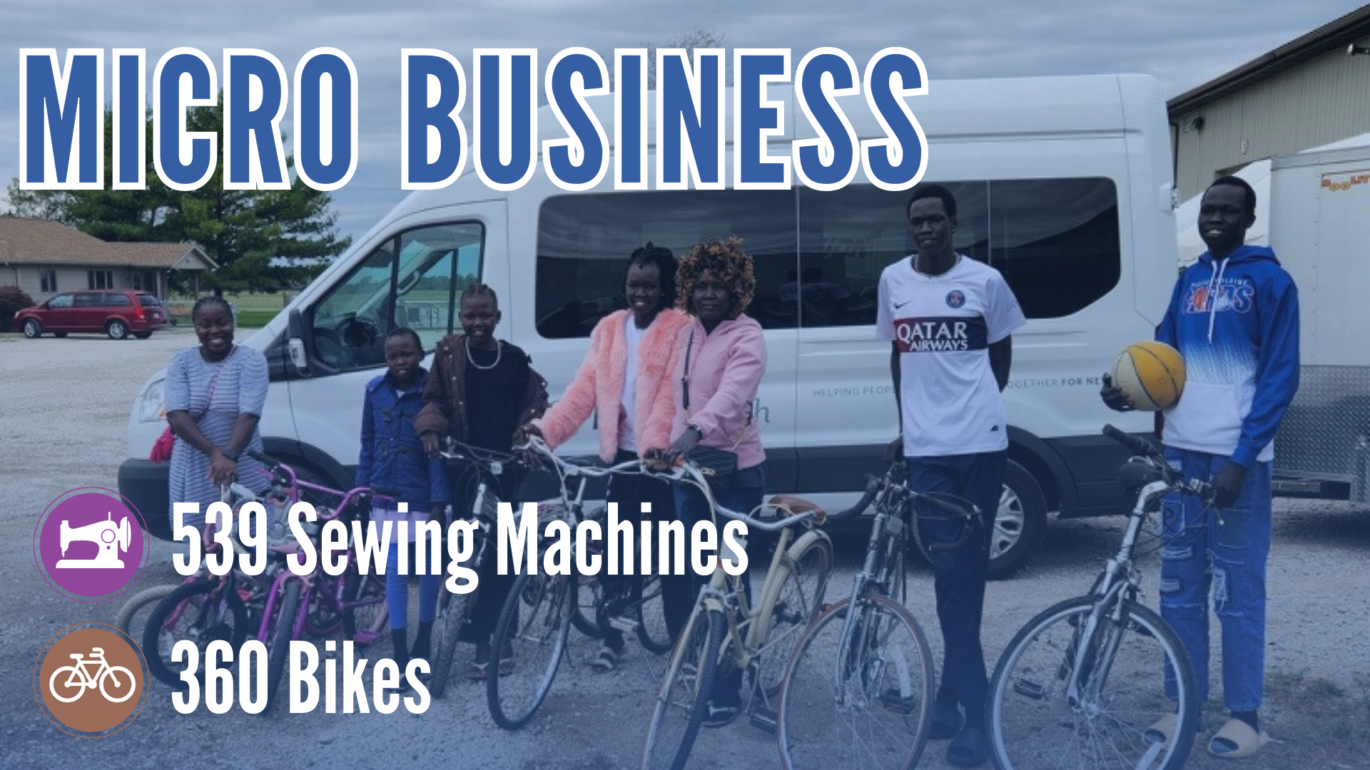
Notes:
Bikes to a Family from South Sudan
The Dengs are a beautiful family of seven from South Sudan. Ten years ago, the family fled scenes of Civil War and violence in South Sudan, and became refugees, living in a refugee camp in northern Kenya. Kenya was their new place — one of safety, but quite different from their home. The Dengs lived there for 10 years, knowing they would eventually relocate to America. The last week of September 2023, their relocation to America became real, leaving their second home, and landing in Springfield, IL.
One of their biggest challenges was transportation. How would they get to
and from work and school and the grocery store? Thankfully, Beth, Community Pastor at Hope Church, knew just the place they could get transportation. On October 6, Beth brought several members of the family on a trip to Midwest Mission. They arrived and walked into the sprawling warehouses. In front of the group was our trailer full of refurbished bicycles, ready to be taken home. Each person looked through and picked out their very own bike! The Dengs loaded up their new-to-them bikes, and headed home with peace of mind that their transportation was taken care of within this new world.
“These bikes will be a real blessing,” Beth said. “Thank you, Midwest Mission!”
So, thank YOU! Your prayers, monetary support, donations, and time played a part in getting this family the transportation they needed. With this weight off of their shoulders, they are better equipped to live a fuller life in Central Illinois.
That’s why we do what we do here at Midwest Mission - to transform God’s resources into humanitarian aid, to send hope and empowerment around the world and around the corner. And, sometimes, we can help people from around the world who have ended up just around the corner!

Slide 20
Notes:
Treadle sewing machines and fabric were delivered to “Manos Emprendedoras” (Enterprising Hands) in Honduras. This is a tailoring workshop, designed to teach interested young people the skill of sewing.
“Our vision is to create job opportunities for women with limited resources so they can have a better way of life and be able to support their families,” our in-country partner, Heydy, said.
This workshop is a model for other projects, making a better future for young people around
Honduras. Because of the donation of sewing machines, and the opportunities Manos Emprendedoras gives, lives are changed forever, and hopefully for generations to come. Thank you for being a part of that impact.

Slide 21
Notes:
Midwest Mission is not the staff - it is YOU! Our prayer partners, donors, and volunteers!

Slide 22
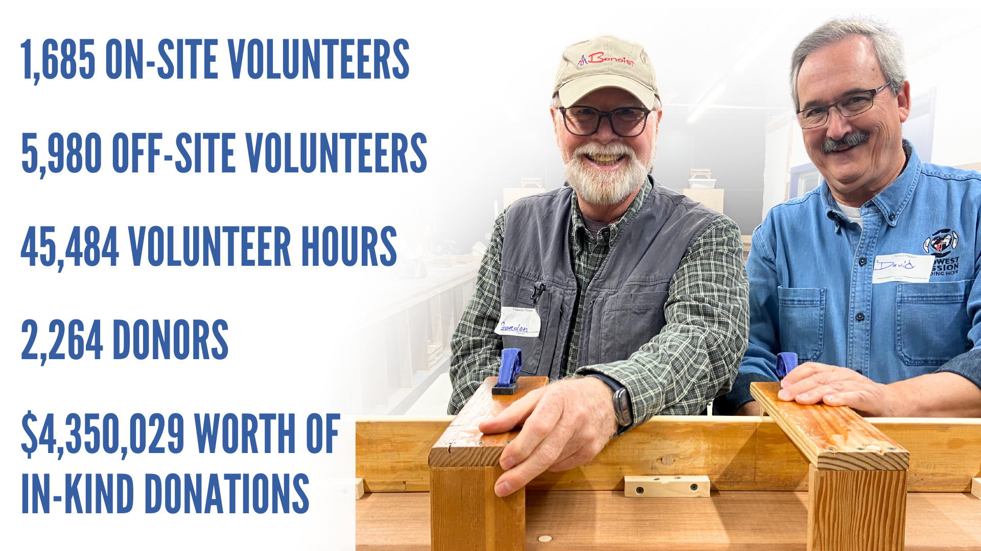

Slide 23
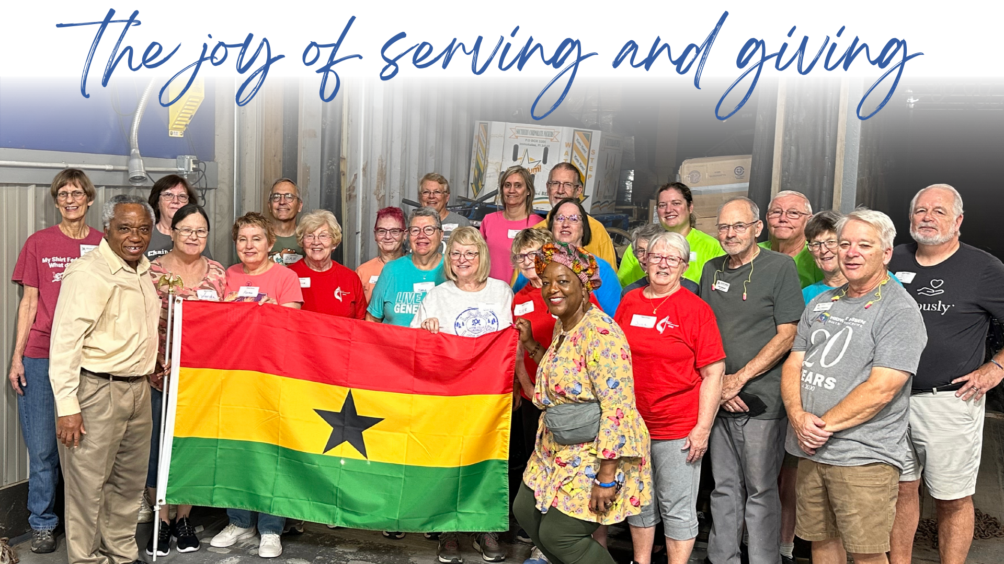

Slide 24
Notes:
Hosting a Rice Meal Pack is a great way to get your group or congregation involved in serving, while building community at the same time. Whether you have a group of 10 or 100s, the Rice Meal Pack is a big blessing to those you will serve, and those you serve alongside. It is something everyone can do — all abilities and ages will enjoy participating in this hands-on event.
Hosting a Personal Dignity Kit Assembly is a great way to open the eyes of your volunteers to the reality that some people really don’t have the basic necessities. Together, you can be part of the solution and help people in crisis.
Student Kits allow students the chance to excel in their education because they have supplies that will help them reinforce what they learn. This is a great project to host, especially during back-to-school excitement, with school-aged children and their families. It’s a great way to show that there are a lot of people who don’t have basic resources many of us take for granted, and we can help with providing these tools.

Slide 25
Notes:
As an organization, our biggest area of growth in 2023 was our off-site opportunities. We believe this is because of the impact it makes in the churches and organizations hosting them. These opportunities allow us to bring the mission to you. Entire congregations serve alongside one another, new relationships are formed, discipleship happens over packing, and churches are revitalized with a renewed excitement for being the hands and feet of Jesus. Not to mention, so many resources are packed and quickly sent to people in need.
As we look ahead to 2024 and beyond, we want to invest our efforts in our areas of growth. So, we are starting the Midwest Mission Experience at Midwest Mission Iowa, and on select days at Midwest Mission Illinois. Midwest Mission Iowa opened in June 2023. With every new project, there are always transitions that occur. As 2023 was winding down, Midwest Mission leadership reflected on the first several months of Midwest Mission Iowa’s operation. The new location was a success, but not without challenges. It became clear that this location could not operate like the main location in Pawnee, Illinois. As a result, leadership began to plan a new format for our Iowa location that would better suit the needs of Midwest Mission, the needs of those we serve, and the needs of the congregations we partner with. With this in mind, as we enter into 2024, Midwest Mission Iowa will be a training ground for off-site and at-home opportunities. We are calling it the “Midwest Mission Experience.”
THE MIDWEST MISSION EXPERIENCE A team of people from a church or organization can come to Midwest Mission to experience several different hands-on, easy mission activities. They will learn about Midwest Mission, learn how they can make a greater impact in the world from right at home, and leave with the tools and knowledge to take this to share at their church or organization.
Maybe your church is excited about mission, but doesn’t know how exactly to get the community involved, or you have heard about Midwest Mission, but need to show others what exactly you’ve been talking about. Or, maybe COVID really separated your congregation, and you need something that would bring everyone together and back in the building. Maybe there are people that want to serve, but need something that is easy, accessible, and can be done in homes or in small groups.
There are a lot of reasons you might be looking for a new mission opportunity, and there are ways for everyone to impact the world from right where they are. But, the problem is, many people just don’t know what to do! The Midwest Mission Experience allows people to try out several different hands-on opportunities with a group of volunteers, and learn for themselves what will be best for their community. The best part is, as you are trying out different stations, you are still being the hands and feet of Jesus! The items you pack at Midwest Mission will be shipped to a person in need around the world or around the corner.
HOW IT WORKS
Gather a group of volunteers who are interested in learning more about mission projects.
Call our Reservations Coordinator at 217-483-7911 to reserve a date for your shift. Midwest Mission Iowa is now solely hosting Midwest Mission Experience days. Midwest Mission Illinois will host Midwest Mission Experiences on select days, as well as regular shifts. Call for availability. Watch the newsletter for upcoming days.
The cost is $6 per person for a half-day or $12 per person for a full-day shift.
You will come and try out Rice Meal packing, Student Kit assembly, Personal Dignity Kit assembly, making Sleeping Mats with a loom, and sewing projects.
When you return home, you should share your experience, and begin planning a mission experience at your location. This could be coordinated through Midwest Mission, or you can do it on your own! Either way, your community will be united, revitalized, and filled with joy from serving with one another. And we are ready to help!

Slide 26
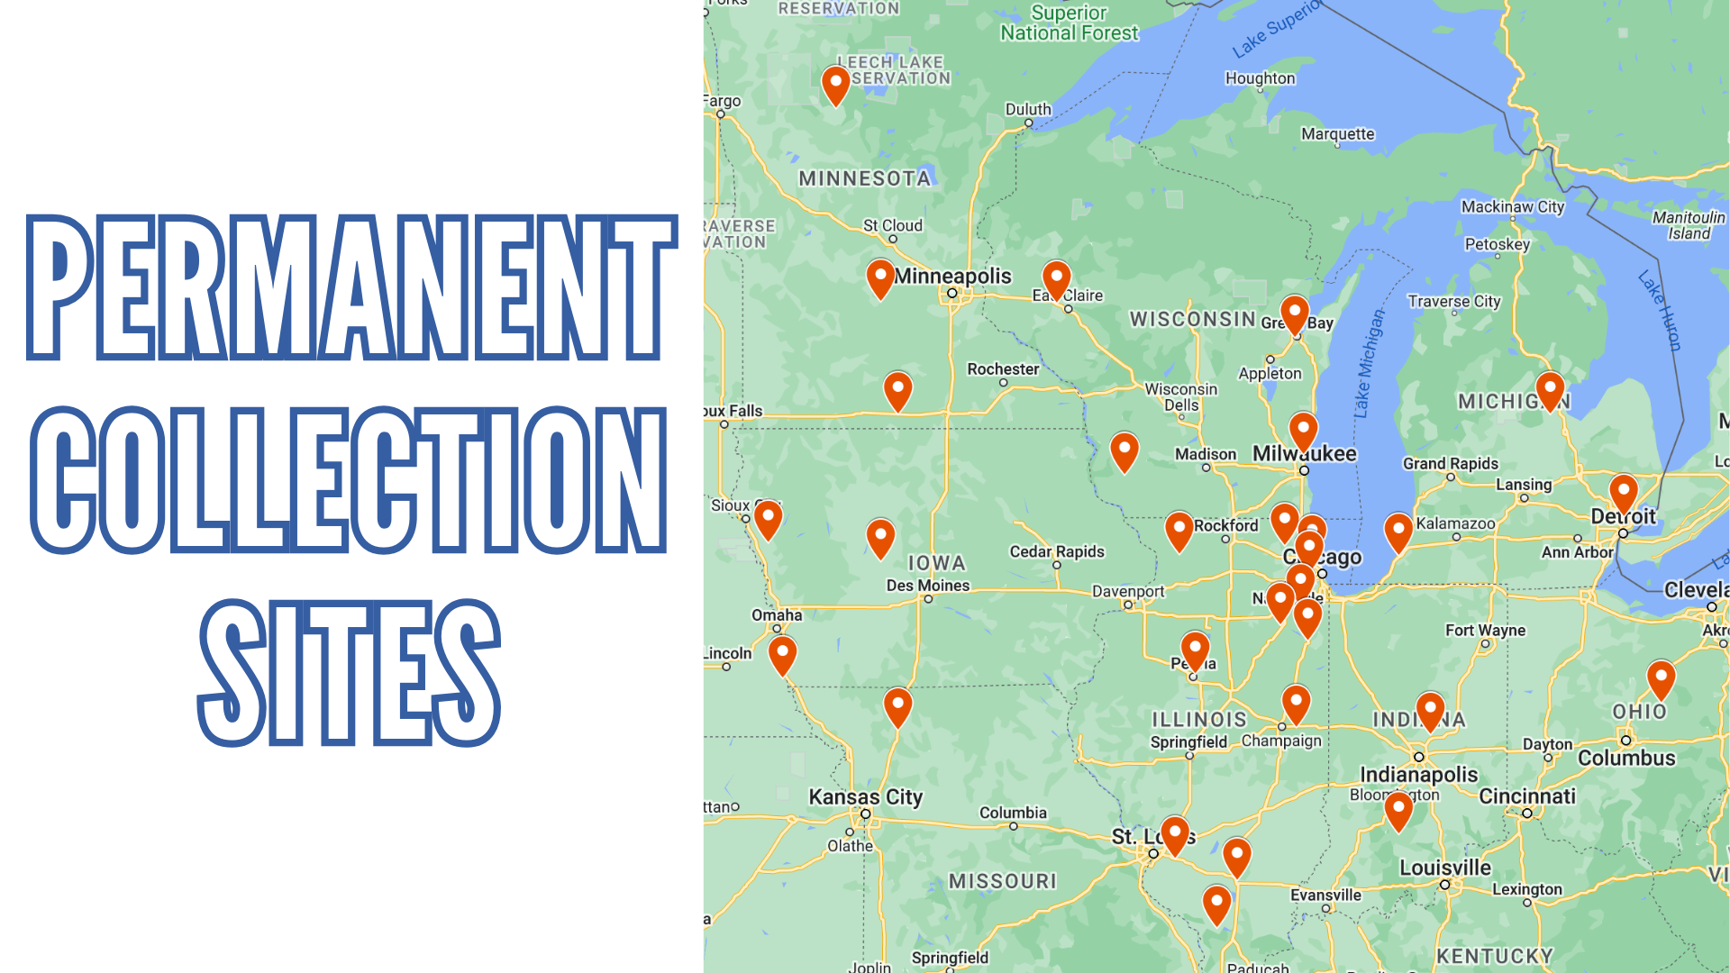
Notes:
We have a network of Permanent Collection Sites across the Midwest that allow you to easily donate items without having to travel to Midwest Mission. Our Permanent Collection Sites accept anything that is on our lists. Visit midwestmission.org/collect-donate to see what is accepted.
For site hours, contacts, and current information,
visit midwestmission.org/permanent-collection-sites.

Slide 27
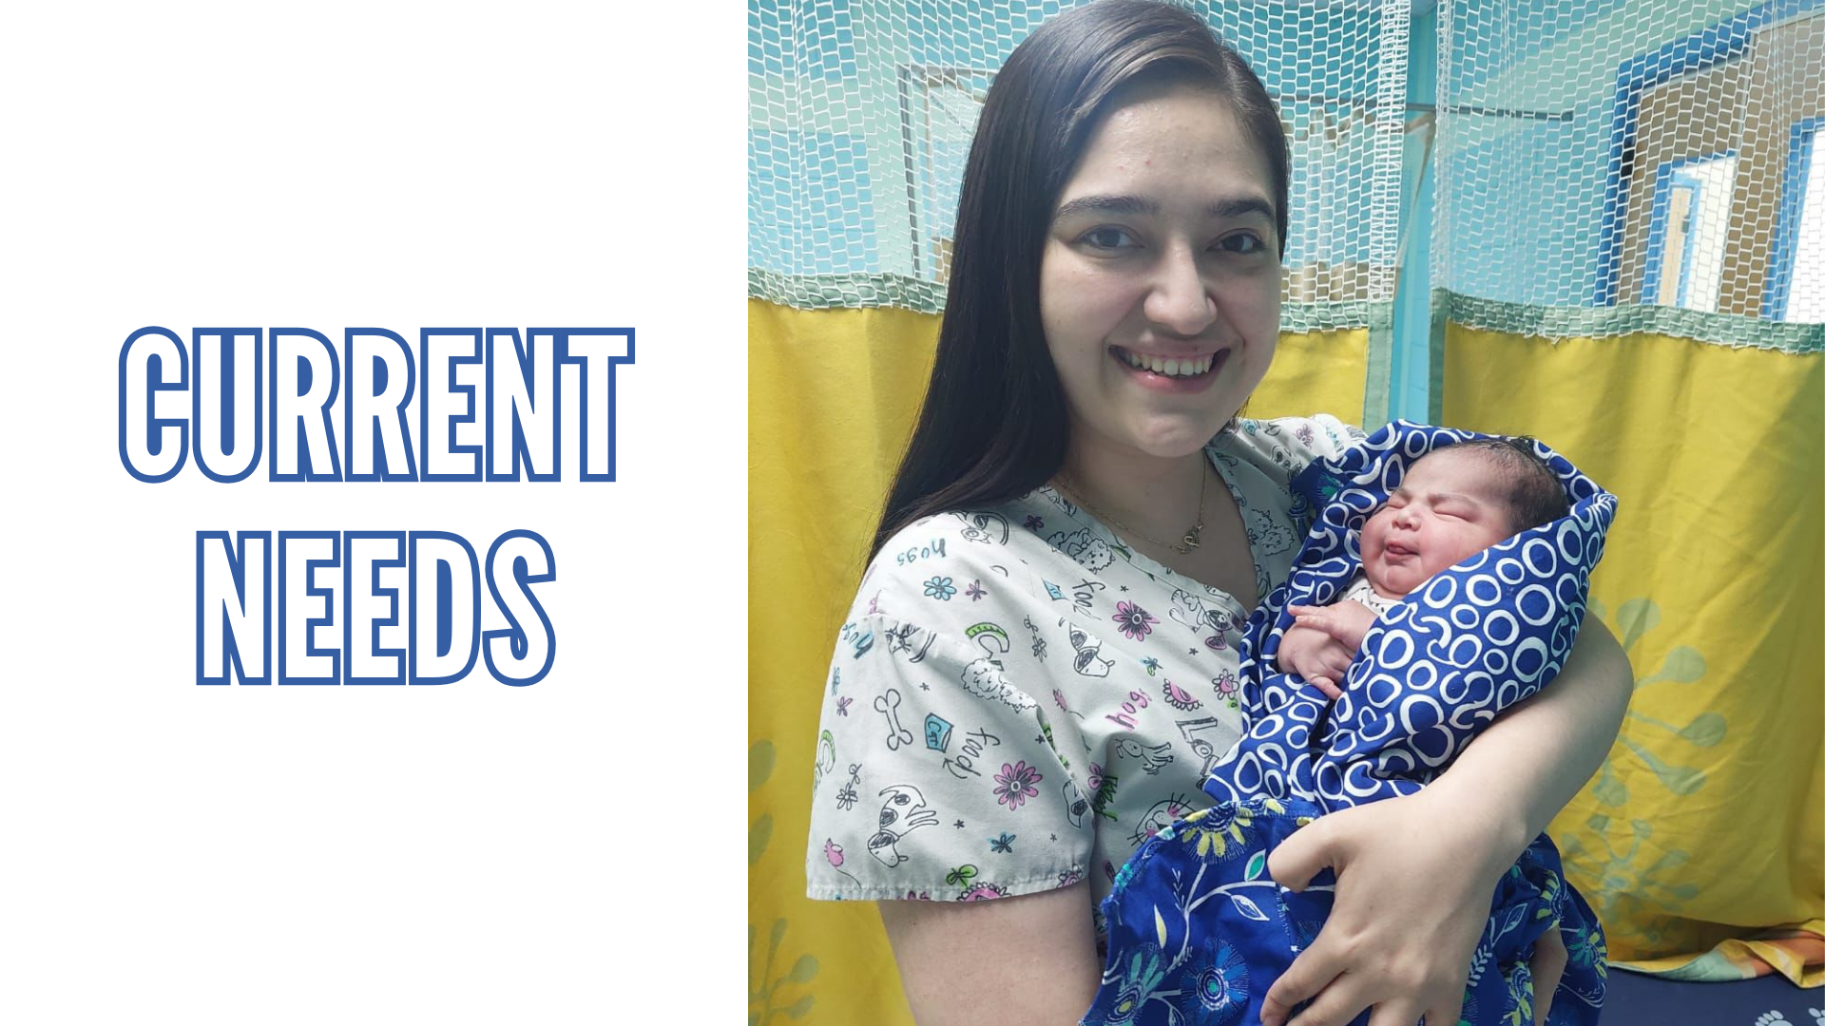
Notes:
Insert what our current needs are!
If you aren’t sure, we always need Kit Supplies, Medical equipment and supplies, bleacher wood, and fire gear.

Slide 28
